Slide 1
Nuyakuk River Hydroelectric Project Status Update
2023 Bristol Bay Sustainability Summit
March 23, 2023

Slide 2
Nushagak Cooperative
Our mission - We exist to serve our members in a cooperative spirit, providing competitive, reliable and safe services at cost consistent with sound management. We will continually evaluate the needs of our members and take an active role in development of opportunities advantageous to our members.
Nushagak Cooperative is the local member owned utility that has been providing power to Dillingham and Aleknagik since the early 60’s.
Through substantial upgrades we have been able to provide for all the salmon processing load as well as our residential load out of our diesel power plant, that could change with load growth. Our last upgrade was right at 14 million dollars to add two generators and upgrade the switch gear. Load growth will bring the need for further investment in production in one form or another.
Our focus right now is to study this resource and use the results of those studies to determine whether or not this project is viable, what we realize is we are not in a energy crisis right now, which allows us to be objective in our assessment of information from the studies.
Genuinely interested in exploring alternative energy sources that take us away from diesel generation to a more renewable, long-term power source

Slide 3
Project Area

Slide 4
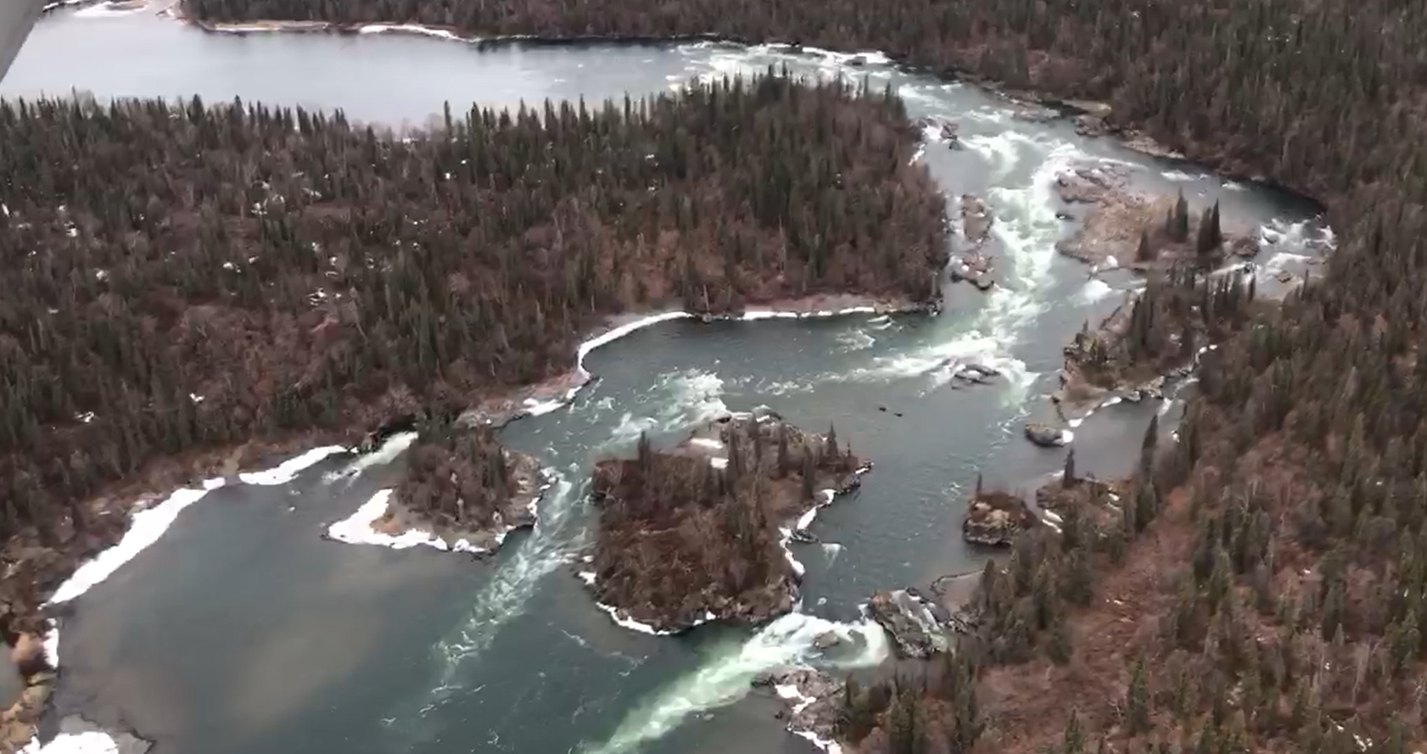

Slide 6
Summary of Regulatory Milestones Since Abeyance Lifted
Revised PSP filed
Substantive collaboration with ARWG related to study refinement
RSP filed with FERC
SPD received from FERC
Consistent collaboration with the ARWG and FERC
NETC Organized over 110 Informational Meetings and Presentations (31 in the region) – October 2017- March 2023

Slide 7
Key Developments over the past year
Collaborative ARWG and public involvement related to technical study plan improvements (collective development, review and commenting)
Geotechnical analysis
Site-specific methods testing
All natural resource study leads in place
Biological study camp established
All requisite natural resource permit applications submitted
Development of life cycle and economic models
Cooperative agreements reached with BBSRI, BBNA and ADFG related to certain study elements
Multiple ARWG and public meetings along with presentation at relevant regional conferences

Slide 8
Study Program Intent
Document baseline conditions
Gain a better understanding of aquatic species abundance and composition near the project area
Utilize aquatic modeling techniques to assess fish passage and behavior over a variety of flow/operational scenarios
Determine potential impacts to migratory wildlife, vegetation and wetlands as a result of transmission development
Assess potential impacts (positive and negative) from Project development and operations
Ultimately – Make determinations on the feasibility of Project development based on quality site-specific science

Slide 9
Natural Resource Study Program
Fisheries
Fish Community and Behavior Near the Project Area
Falls Fish Passage Study
Entrainment and Impingement Study
Tailrace False Attraction Evaluation
Chinook and Sockeye Life Cycle Modeling
Integrated Risk Assessment of Fish Populations
Water Resources
Dissolved Oxygen and Water Temperature Focus
Flow Duration Curve/Stationarity Assessment
Future Flows Study
Ice Processes Assessment

Slide 10
Natural Resource Study Program
Terrestrial
Botanical Impact Assessment
Wetlands Impact Assessment
Caribou Population Evaluation
Cultural
Subsistence Study
Section 106 Evaluation
Recreation and Aesthetics
Noise Study
Recreation Inventory

Slide 11
Next Steps 2023
Coordination and logistics throughout - Ongoing
Complete biological study camp set-up – April/May
On-board camp managers - April
Formalize all requisite permits – March - May
LiDAR and habitat mapping – April/May
Commence study program – May/early June
Data analysis and reporting – July - November
ISR – December

Slide 12
Next Steps 2024 and Beyond
2nd study season
All resource areas
Further geotechnical analysis
Refined conceptual design based on study results
Data analysis and reporting
Collaborative decisions related to project feasibility begin
Ongoing consultation/meetings/project updates throughout

Slide 13
Overall Conceptual Schedule
Key Milestones
Comprehensive Study Seasons – 2023 and 2024
Study Reporting – 2023 and 2024
Study Reporting Meetings – 2023 and 2024
Ongoing Infrastructural and Site Analysis and Design – 2023-2024
Further Geotechnical Analysis –2024
Preliminary Licensing Proposal – 2024/early 2025
PLP Comment Period – 2024/early 2025
Final License Application – 2025

Slide 14
Cooperative Intent
Genuine desire to be transparent, inclusive and proactive with the feasibility evaluation
Make decisions on that feasibility with potential impacts to the natural environment at the forefront
Establish a more reliable power grid that minimizes/eliminates the need for fossil fuel generation and provides the potential for growth in the public and commercial areas
Create a more long-term and cost-effective energy platform for the region
Potentially provide the supplemental (but significant) benefit of a fiber optic upgrade to outlying communities

Slide 15
Thank you
Questions?

