Slide 1

Where to now?
Renewing conversations on restoring fisheries access in Bristol Bay
Rachel Donkersloot, PhD
Coastal Cultures Research
Aniak, AK

Slide 2
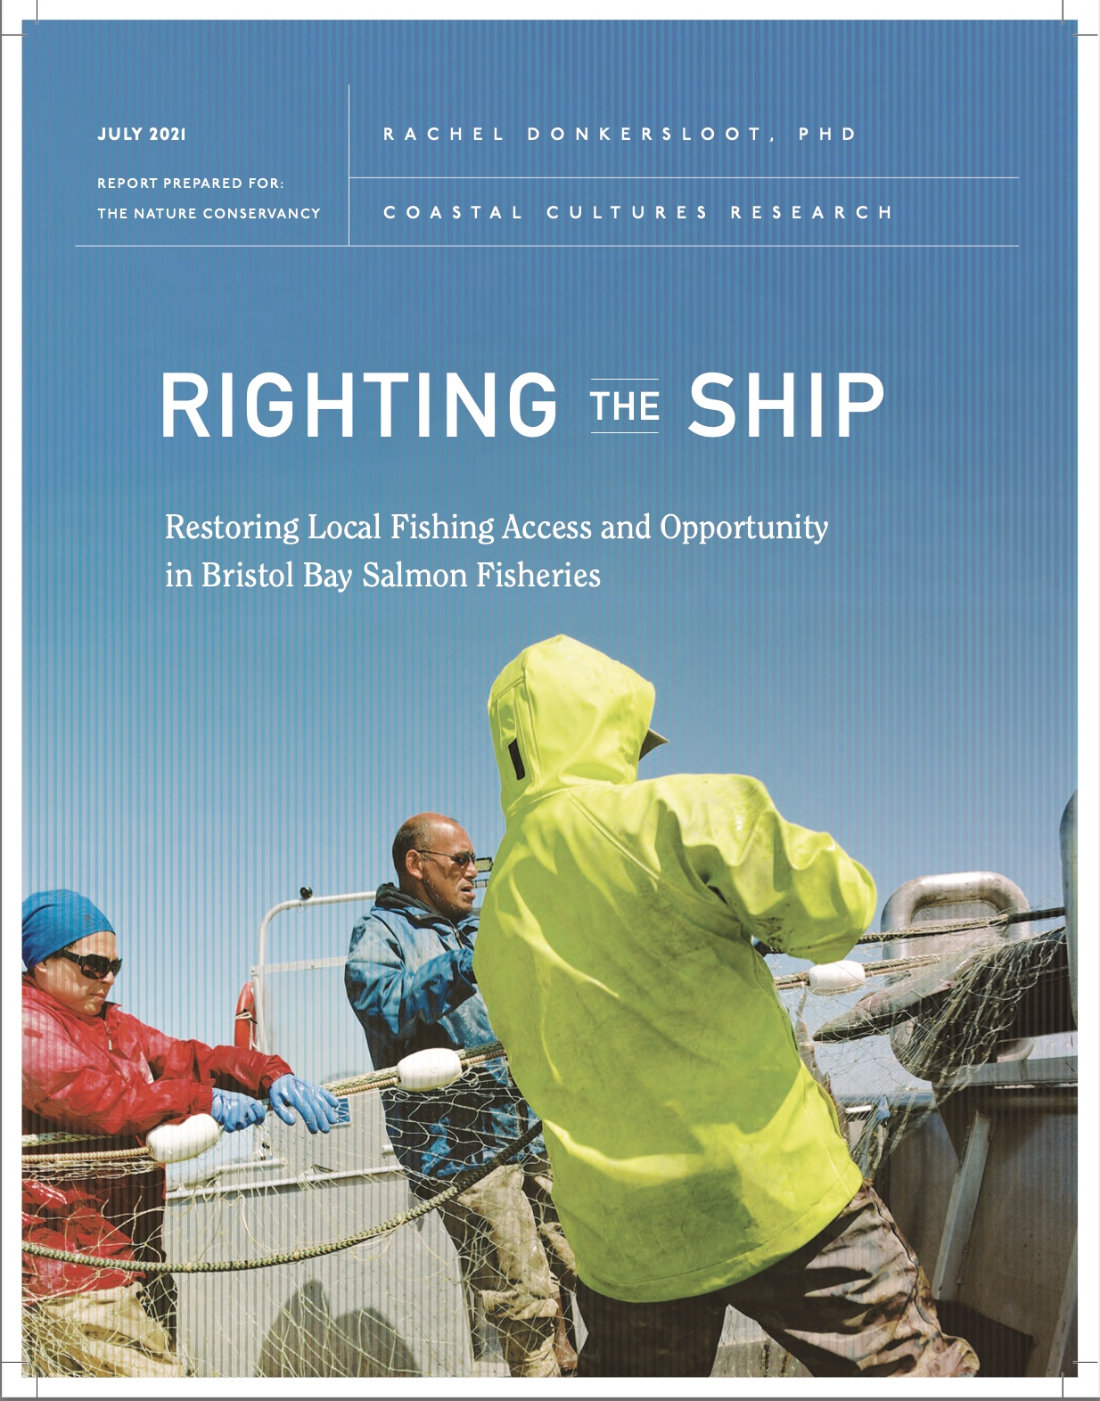

Slide 3
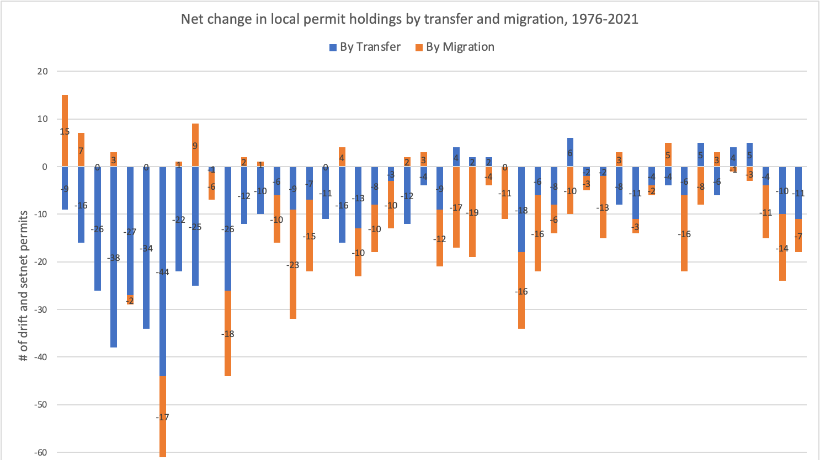

Slide 4
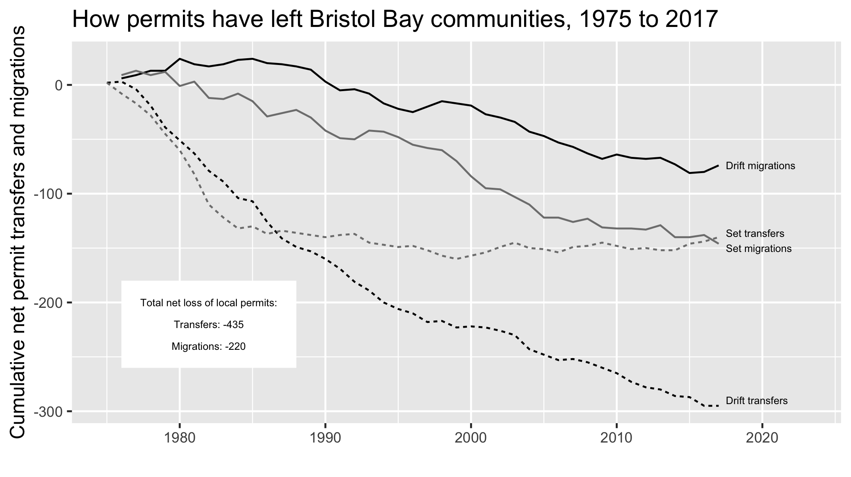

Slide 5
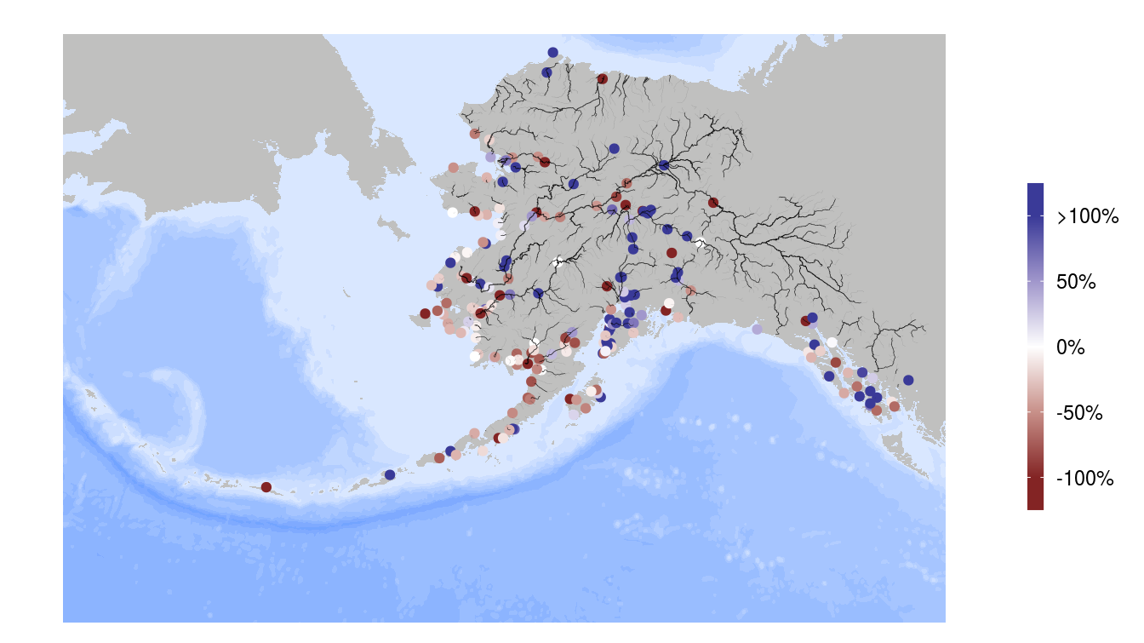

Slide 6
Limited Entry: Application Process
Application process based on points system (hardship ranking system)
Modeled after ‘non-rural fisherman’ (Koslow 1986)
  Assumed all fishermen “full-time, highly efficient, fully entrenched in market economy, maintained written records of income” (ibid.)
Low local participation in 1971-1972 (qualifying years) due to poor salmon returns (Langdon 1980)
3 out of 10 Bristol Bay residents eligible to apply for a limited entry permit did not do so (Petterson 1983)

Slide 7
Limited Entry: Objectives
“prevent economic distress among fishermen and those dependent upon them for a livelihood” (Alaska Constitution VIII:15).
“keep fishing rights in the hands of Alaskans dependent on fisheries, especially rural residents with limited alternative economic opportunities” (Knapp 2011).
support a “stable economic base in the relatively isolated fishing communities where fisheries occur” (Kamali 1984:2).

Slide 8
Free Transferability
Concern about barriers to entry due to increasing entry costs to ‘undesirably high’ levels (CFEC 1975:4; see also Fraser 1979).
Concern about fishery participation in rural and Alaska Native fishing communities (Langdon 1980; Rodgers and Kreinder 1980).
But... free transferability
  avoided creating a closed class of fishermen (CFEC 1975);
  minimized government interference;
  passed constitutional muster where prior attempts had failed

Slide 9
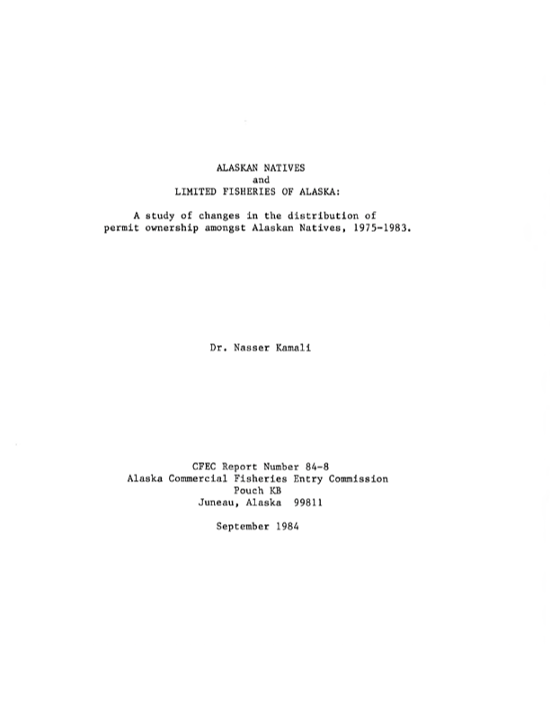
Disproportionate Impacts & Data Gaps
1975-1983: -21% decline (-288 permits) Alaska Native permit holdings in Bristol Bay (Kamali 1984)
1980-2019: BBNC shareholder analysis
  Local shareholders
    -47% decline (-470 permits)
  Local non-shareholders
    -17% decline (-35 permits)

Slide 10
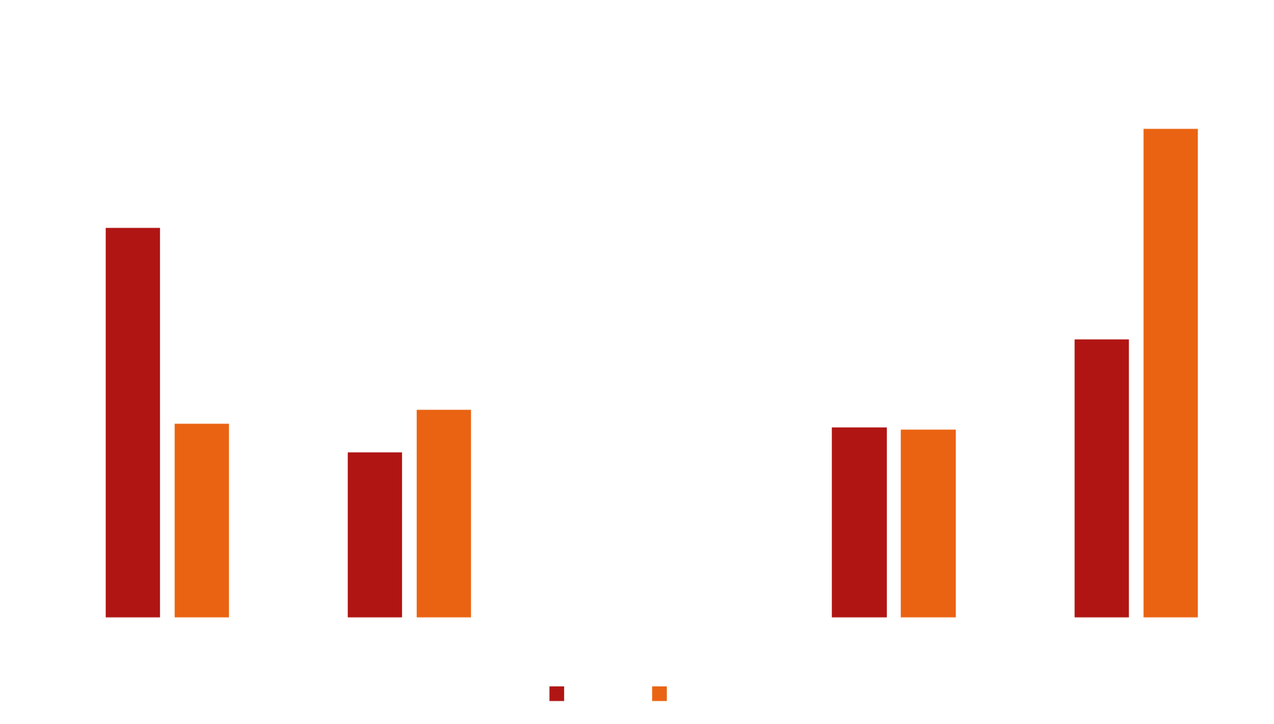
Shareholders

Slide 11
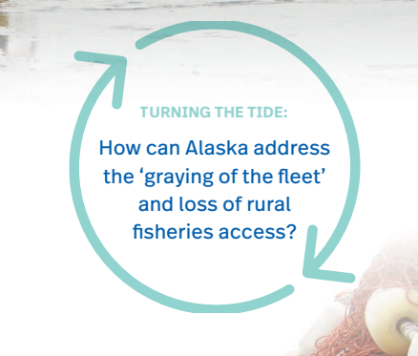
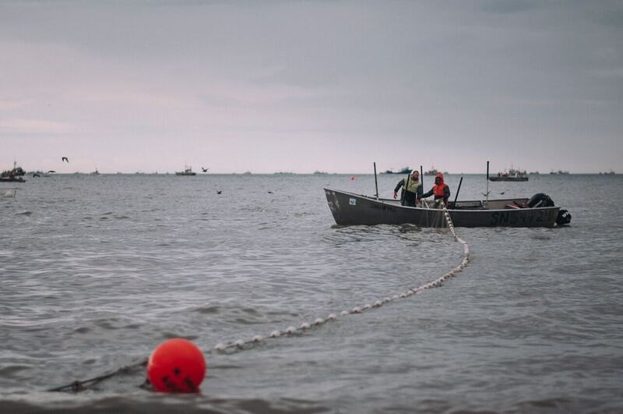
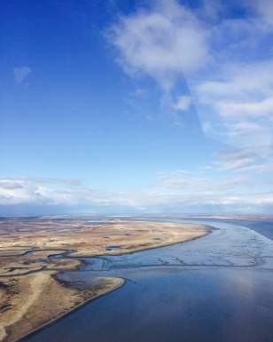
Considering solutions
Community considerations
  accounting for community-based livelihoods & diversity
Legal considerations
Policy considerations
Notes:
Considering

Slide 12
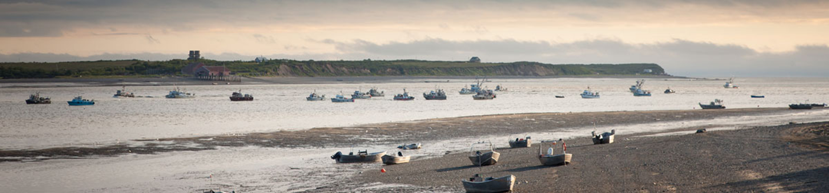
Where to now?
Re-elevating the issue
Regional dialogues guided by regional values
Statewide dialogue

Slide 13
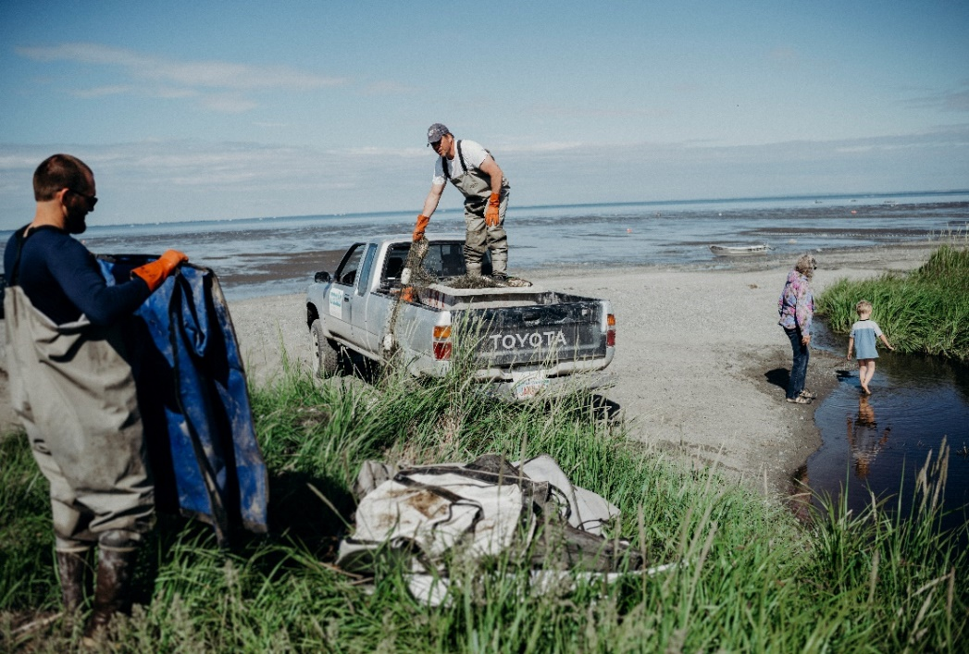
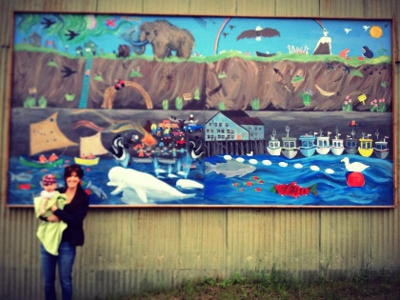
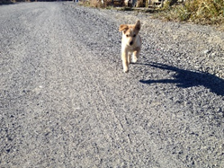
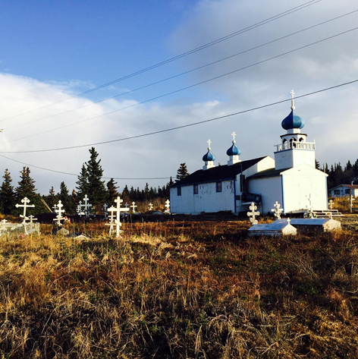
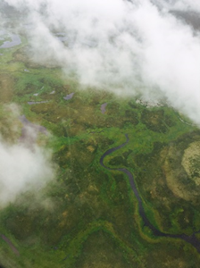
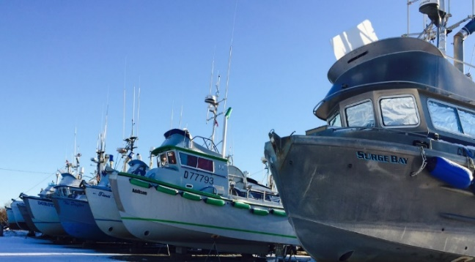

Quyana/Thank you! Keep in touch!

Slide 14
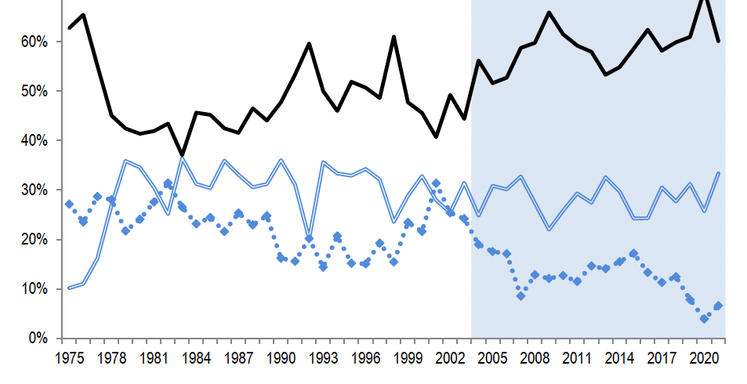
Notes:
Rate of New Entrants into Bristol Bay Drift Gillnet Fishery, 1975-2021
Dual permit operation regulation starts in 2004…

