Slide 1
UAF’s Sustainable Energy Program - Education and Research Highlights -
Eric Goddard
esgoddard01@alaska.edu
Chandler kemp
ckemp6@alaska.edu
Bristol Bay Sustainability Conference, March 23, 2023

Slide 2
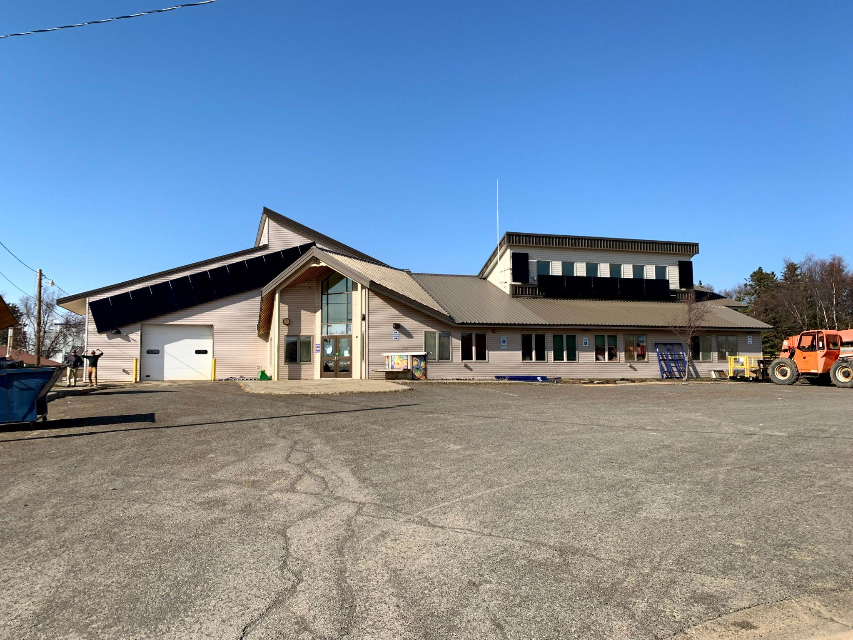
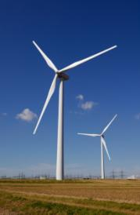
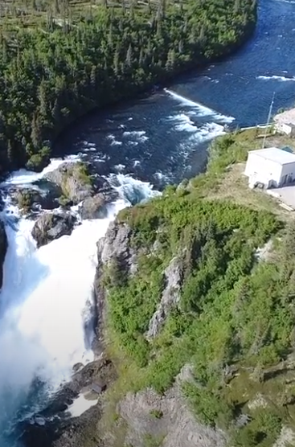
What is “sustainable energy”?
Energy that is produced and used in a sustainable way, i.e. in a way that can persist without exhausting resources or degrading the environment.
2

Slide 3
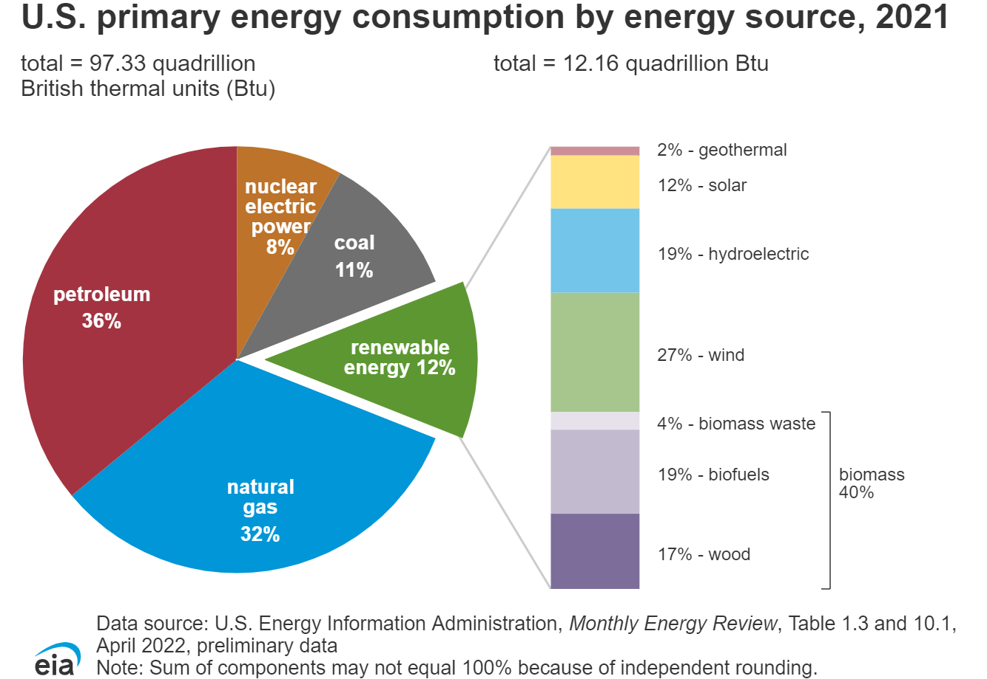
Notes:
Exact link: http://www.eia.gov/kids/energy.cfm?page=about_home-basics

Slide 4
How do we get closer to energy sustainability?
Reduce consumption of fossil fuels through:
Energy Efficiency
Renewable Energy
4

Slide 5
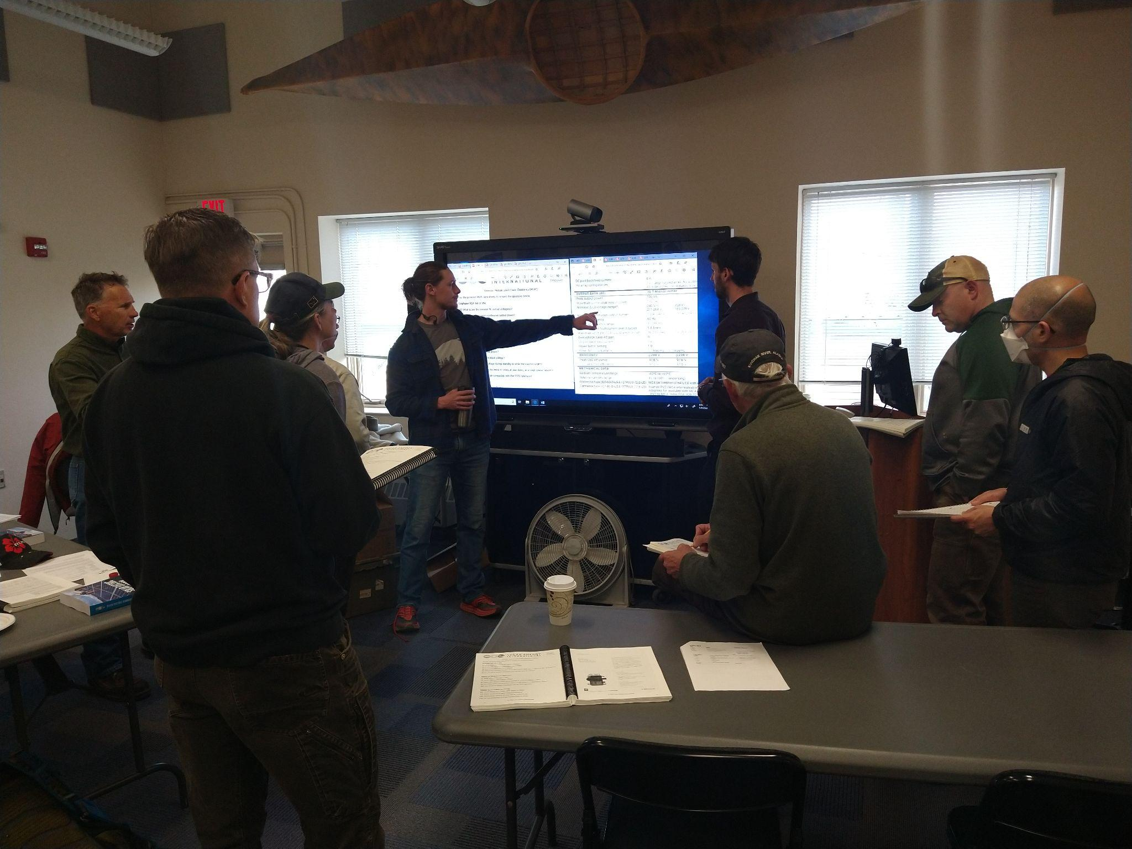
UAF Sustainable Energy Occupational Endorsement
Latest version approved in Fall 2012
12 credits minimum
Required core (6 cr) + electives (6 cr minimum)
Offers distance and in-person delivery options
5

Slide 6
UAF Sustainable Energy OE
6 credits of required courses:
DEVM F105 or CTT F106 or TTCH F131 – basic math course (3 cr.)
ENVI F220 – Intro to Sustainable Energy (3 cr.)**
6 credits (minimum) of electives:
Any one of our technology or ENVI related classes
ENVI F170 - Basics of Solar Energy
ENVI F120 - Home Energy Basics
ENVI F173 - Small Wind Systems
ENVI F175 - Introduction to Biomass Energy Systems
ENVI F174 - Basics of Heat Pump Systems
ENVI F255 - Climate Change and Alaska
ENVI F193 - Hydropower: Communities, Energy and Environment
Special Topics Courses
ENVI F250
ENVI F150
6

Slide 7
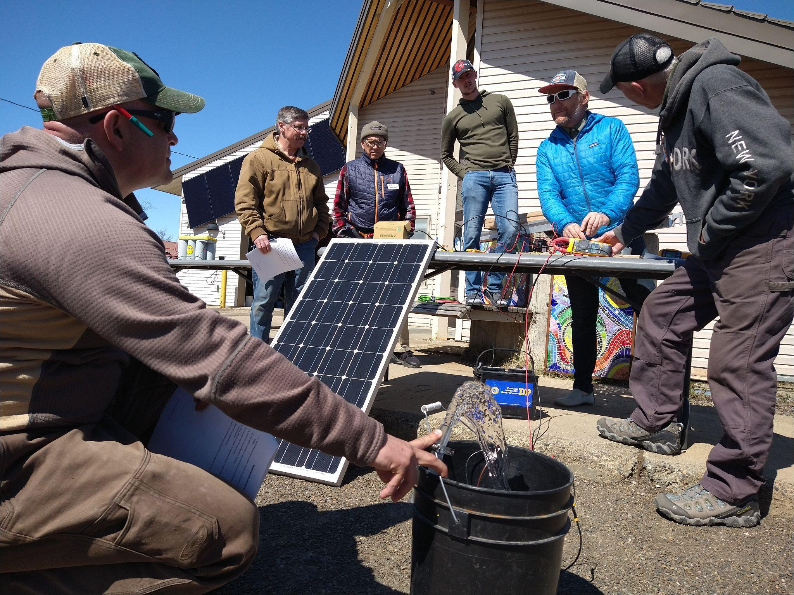
Sustainable Energy Courses Topics Areas Covered
Residential Energy Assessment
School Building Energy Audit
Passive House / Energy Efficient Construction
Building Ventilation and Energy
Wind Energy Development
Solar Power Training
Technicians
Instructors
Hydroelectric Power
Climate Change and Alaska
Environmental Sciences

Slide 8
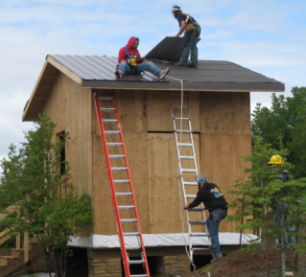
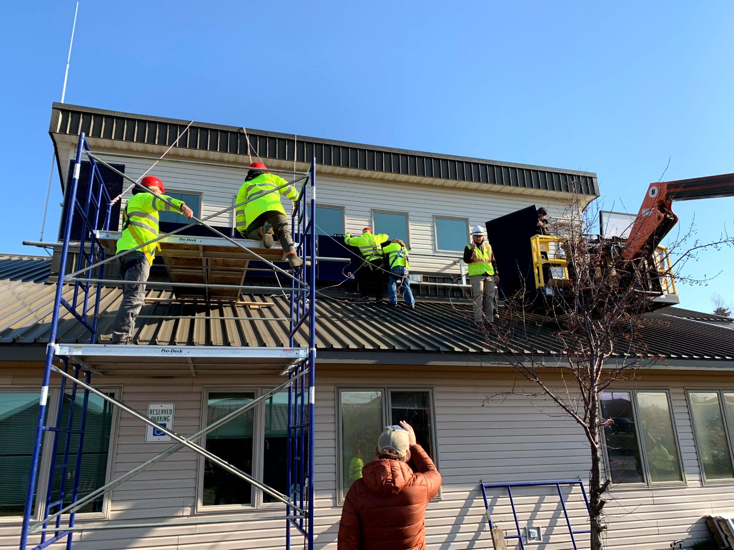
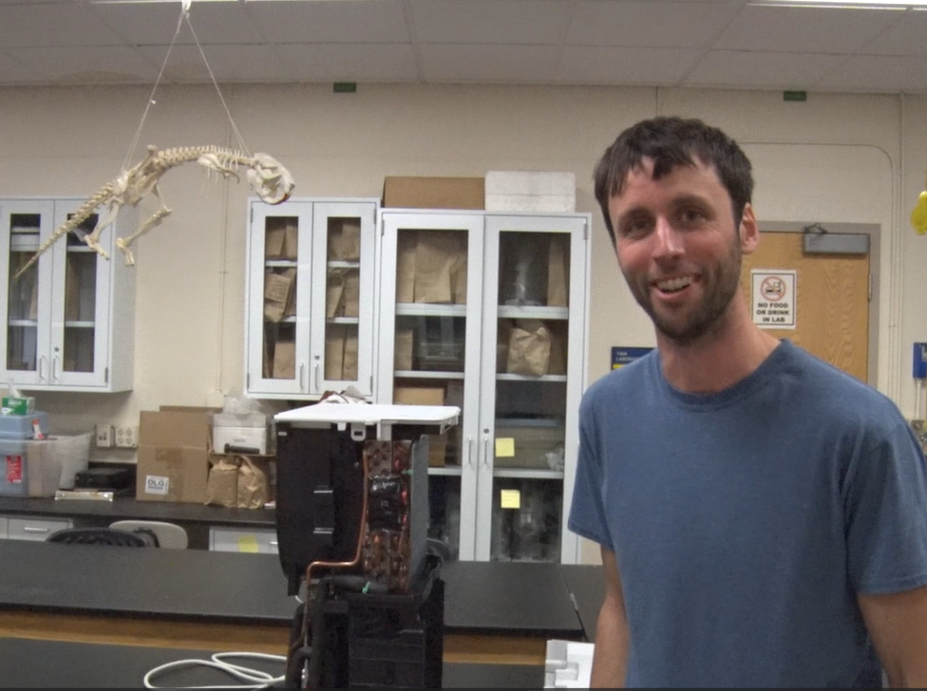
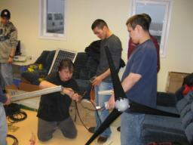
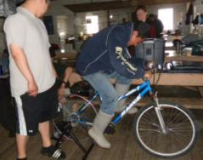
Educational Tools
Solar PV system
Passive House model
Heat Pumps
Solar/Wind Hybrid
Bike Generator

Slide 9
UAF Sustainable Energy OE - Current Status -
How is this Occupational Endorsement being used:
As a starting point towards another degree (e.g. Interdisciplinary AAS in Sustainable Energy)
As an add-on to a different degree (e.g. BS in Electrical Engineering with an OE in Sustainable Energy)
To help people in their current job (e.g. school principal, campus director, grant writer)
To obtain a new job (e.g. solar installer, energy auditor)
To reduce personal energy use and energy bills (added benefit for program participants)
9

Slide 10
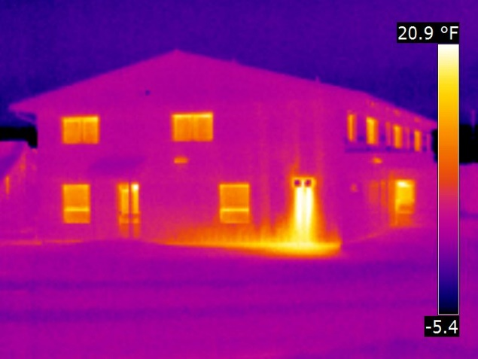
UAF Sustainable Energy OE
Design of renewable energy systems on grid / off grid
Energy consumption behavior of students
Evaluating ventilation options
Feasibility of solar energy in Alaska
Reducing energy use in hospitals
Carbon footprint of locally grown vs. imported food
Energy efficiency of fishing vessels
An invention in heat recovery ventilation
Feasibility of new battery technologies
LED lighting retrofits
Green buildings
10

Slide 11
What can we do for you?
Facilitate locally relevant trainings
Aid in grant development
consultation
partnership
Assist with community outreach and educational initiatives
Facility access
Research development and implementation

Slide 12
Please contact us with suggestions, questions or requests!
Eric Goddard: esgoddard01@alaska.edu
Chandler Kemp: ckemp6@alaska.edu
UAF Bristol Bay Campus: 1-800-478-5109
https://www.uaf.edu/bbc/academics/sustainable-energy/index.php

