Slide 1
Ciulistet: Emerging Leaders Navigate forward based on where you come from
Kristina Andrew
Economic Development
Bristol Bay Native Association

Slide 2
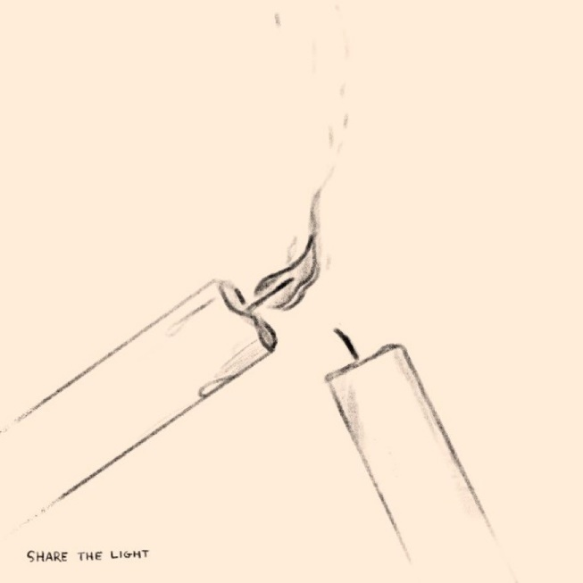
What is Ciulistet?
Leadership Program for young adults
Alaska Native Governance, Tribal Administration, Land and Natural Resource Management, Native Corporations, Leadership, Community Project & Program Planning, Cultural Revitalization
Specialized Internship Opportunities
Building Bristol Bay specific leadership skills and knowledge
Network of peers and mentors across the region
Funded by Administration for Native Americans: Social and Economic Development Strategies, BBNC, BBEDC, and The Nature Conservancy

Slide 3
Who does Ciulistet Serve?
Young Adults ages 18-28
ALL 31 tribes in Bristol Bay
BBNC Shareholders
BBEDC CDQ residents

Slide 4
When does Ciulistet Take place?
The actual internship is January to May (2 retreats, orientation, 5 check in calls)
Recruitment in Fall August to October
Internship Placements in October to December

Slide 5
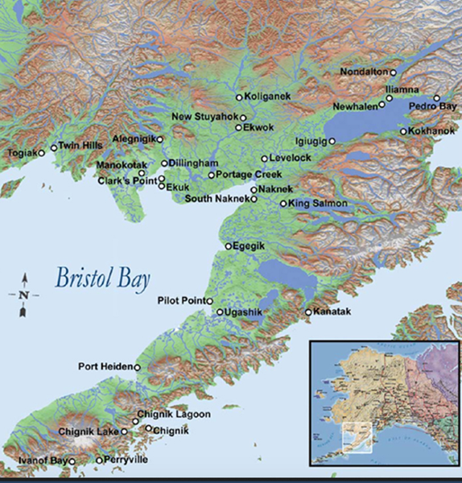
Where does Ciulistet Take place?
First year was all online w/ most participants calling in from in region due to COVID
Second year was in Dillingham and King Salmon
Third year, open to suggestions but need to house and feed15 people

Slide 6
Meet the Cohorts
2022
2023
Natasha Larson- Perryville (ANC UW Student)
Jasmine Kritz- Aleknagik
Courtney Griechen- Pilot Point (ANC)
Brandie Olson- Dillingham
Virginia Andrews- Aleknagik
Joseph Nanalook- Manokotak
McKenzie Nanalook- Manokotak
Angelina Phillips- Perryville
Analouise Hoseth- Dillingham (UAA Student)
Lynette Eversole- Togiak
Mariam Nanalook- Manokotak
Sally Paul- Manokotak
Clarissa Franklin- Manokotak
Angelina Phillips- Perryville
Emma Wetter- Ekuk
Shaun Andrew- Igiugig (ANC)

Slide 7
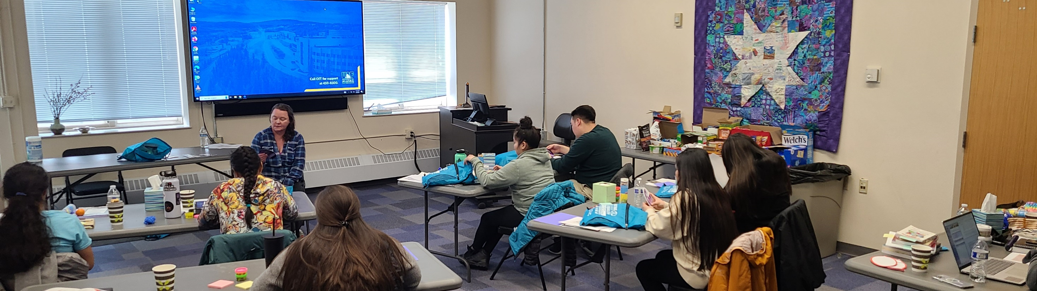
2023 Photos Retreat One

Slide 8
Why Ciulistet?
This started with TNC Two Way Exchange with 4 young adults from across BB
Filling multiple gaps: public schools, jobs, post HS programs, promote team building
Leadership Program for young adults
Alaska Native Governance, Tribal Administration, Land and Natural Resource Management, Native Corporations, Leadership, Community Project & Program Planning, Cultural Revitalization
Specialized Internship Opportunities
Building Bristol Bay specific leadership skills and knowledge
Network of peers and mentors across the region

Slide 9
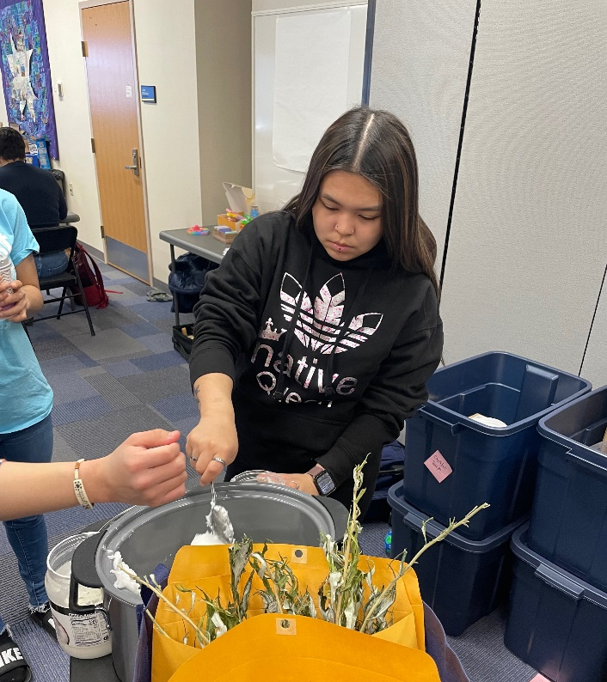
More 2023 Retreat One Photos

Slide 10
Unexpected Outcomes
Full time job placements
Leveraging resource from other program, assisting other programs/ organizations
Human Resources has a complex job-Thank your HR Team
Broad Community Support and Excitement
Smaller Cohort than expected
Bringing young people home or to resources they need
Hope for the future

Slide 11
Young people want to do something meaningful they just need the chance

Slide 12
Quyana –Questions?
Kristina Andrew
907-842-6223
kRandrew@bbna.com
Economic Development
Bristol Bay Native Association
https://bbna.com/program-development/ciulistet-emerging-leaders-internship-program/

